Slide 1

AC Circuits
Sinusoids and Phasors
Section 9.2, 9.5
Md. Shafqat Talukder Rakin
Lecturer, Department of CSE,
United International University
Email id : shafqat@cse.uiu.ac.bd

Slide 2
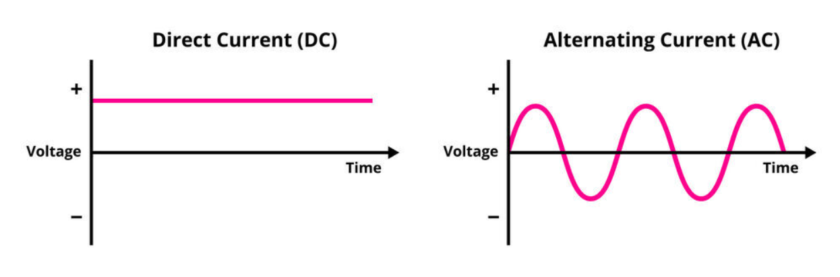
DC VS ac

Slide 3
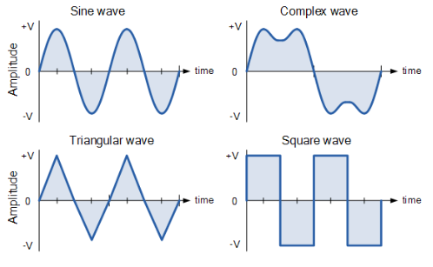
Types of ac waveforms

Slide 4
Our focus

Slide 5
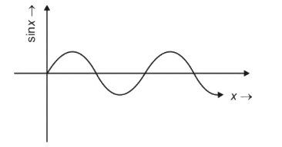
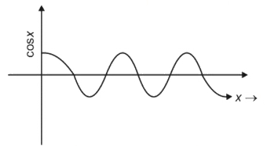
Sinusoids
A sinusoidal current is usually referred to as alternating current (ac).
Such a current reverses at regular time intervals and has alternately positive and negative values.
Circuits driven by sinusoidal current or voltage sources are called ac circuits.

Slide 6
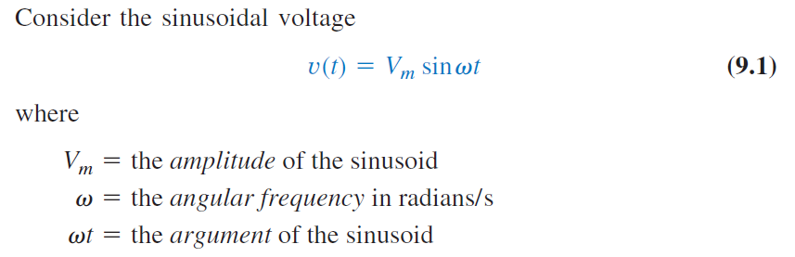
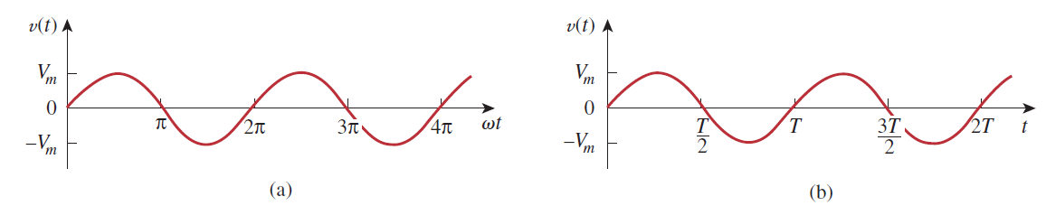
Sinusoids equation

Slide 7




Some formulas
Time period
Cyclic Frequency
Angular Frequency

Slide 8

general expression for a sinusoid

Slide 9
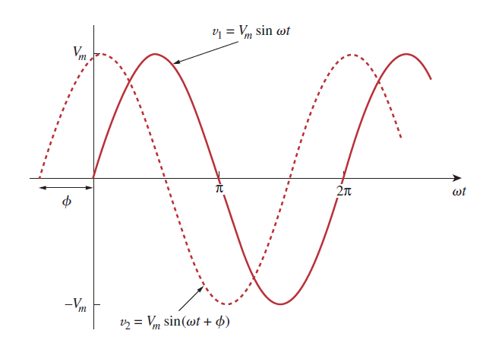
Leading lagging concept

Slide 10
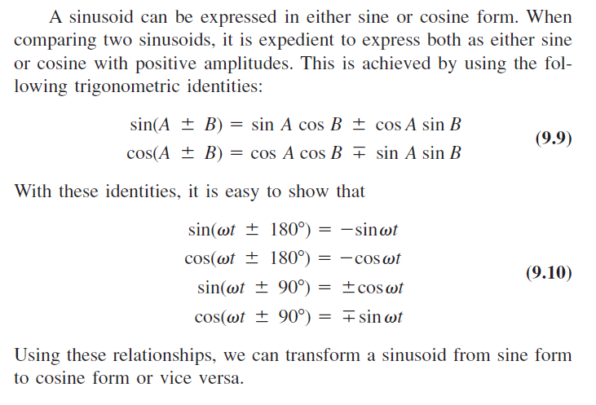
Necessary formulas for comparing sinusoids

Slide 11
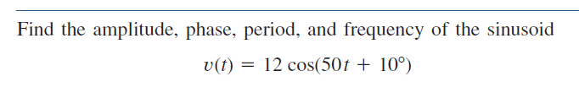
Math Problem Practice:
Reference: Sadiku_Example_9.1

Slide 12
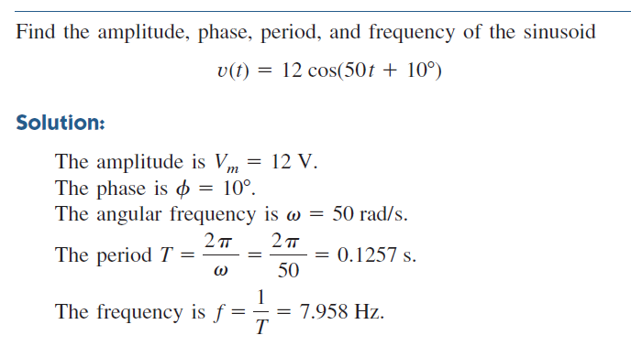
Math Problem Practice:
Reference: Sadiku_Example_9.1

Slide 13

Math Problem Practice:
Reference: Sadiku_Example_9.2

Slide 14
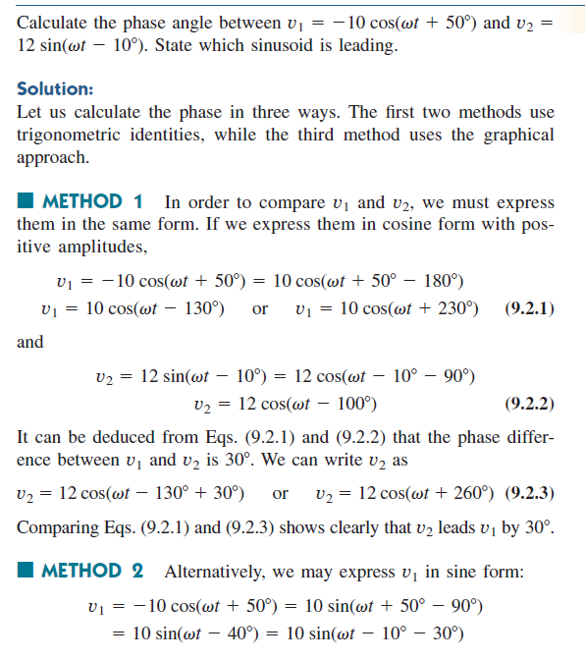
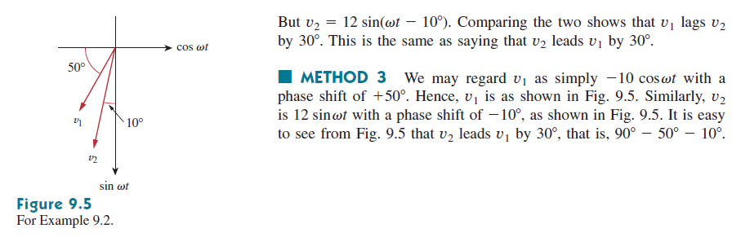
Math Problem Practice:
Reference: Sadiku_Example_9.2

Slide 15
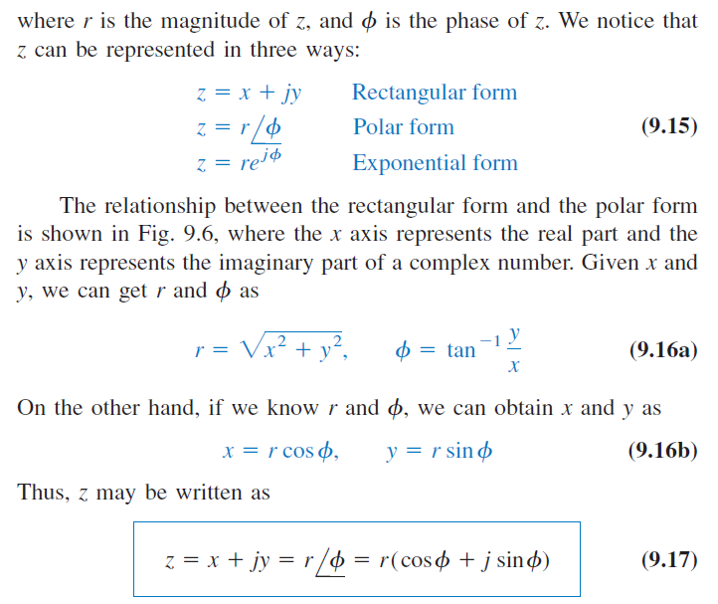
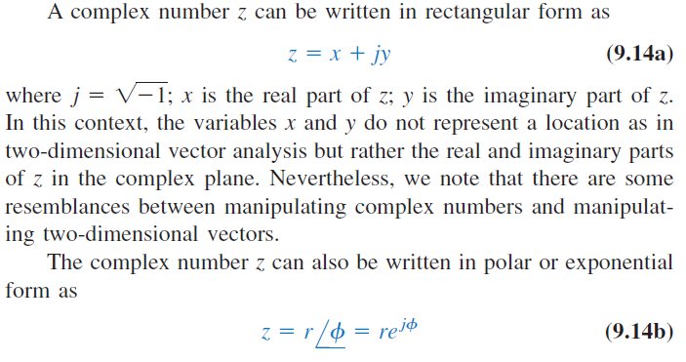
Phasors

Slide 16
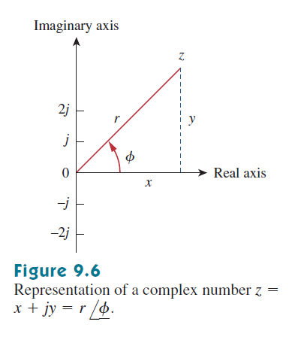
Graphical representation of a complex number

Slide 17
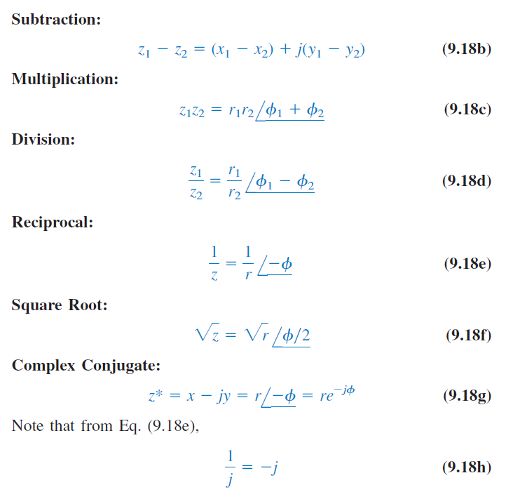
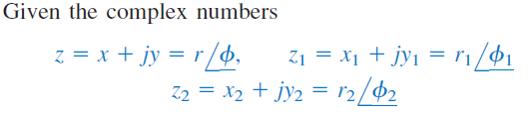

Complex numbers

Slide 18
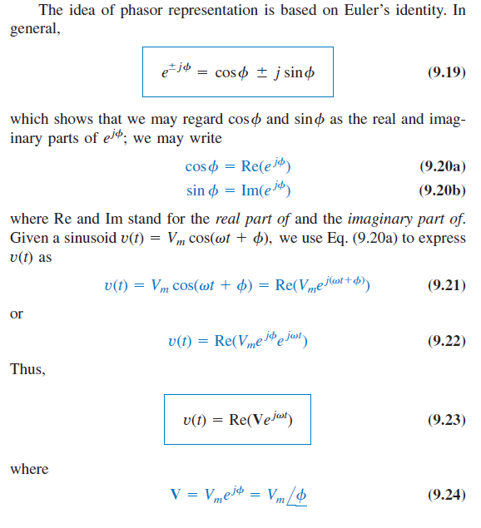
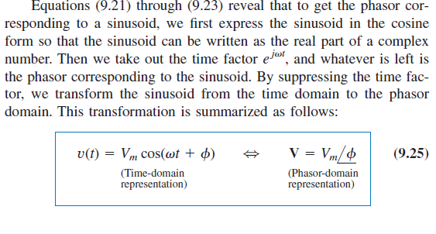
Time domain -> phasor domain

Slide 19
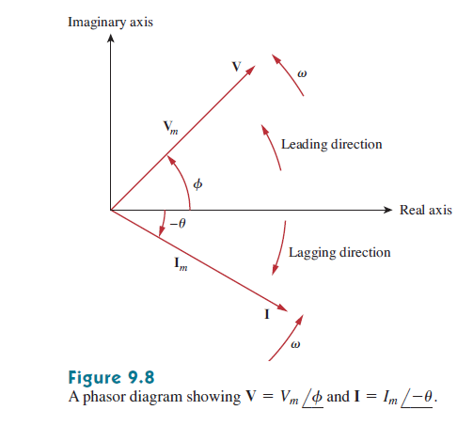
Phasor diagram

Slide 20
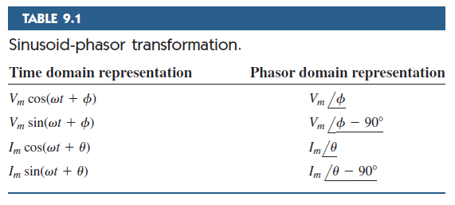
Formulas for phasor transformation

Slide 21
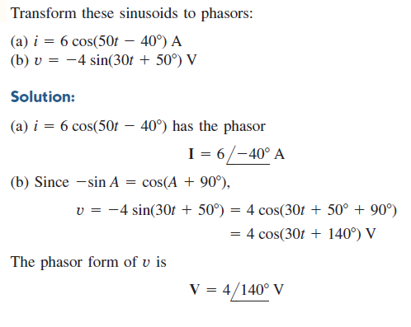
Math Problem Practice:
Reference: Sadiku_Example_9.4

Slide 22
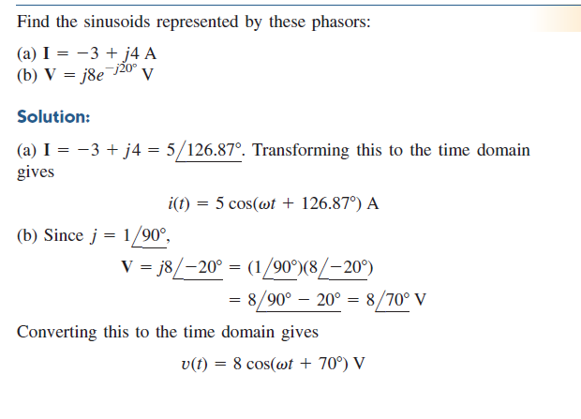
Math Problem Practice:
Reference: Sadiku_Example_9.5

Slide 23
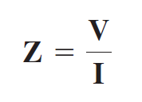
Impedance

Slide 24
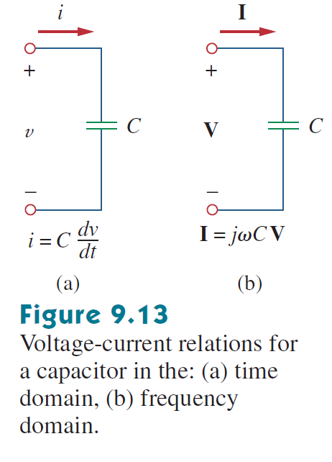
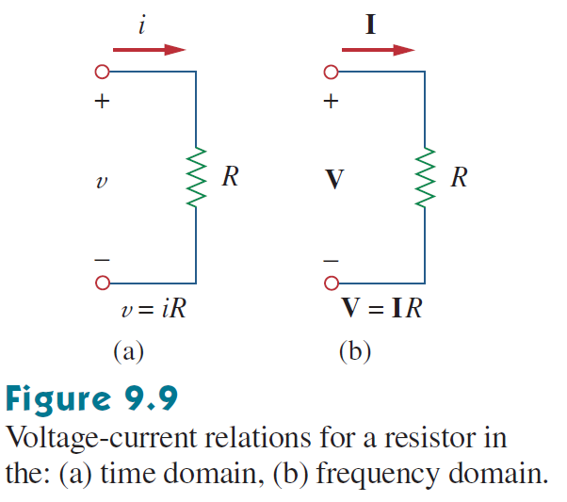
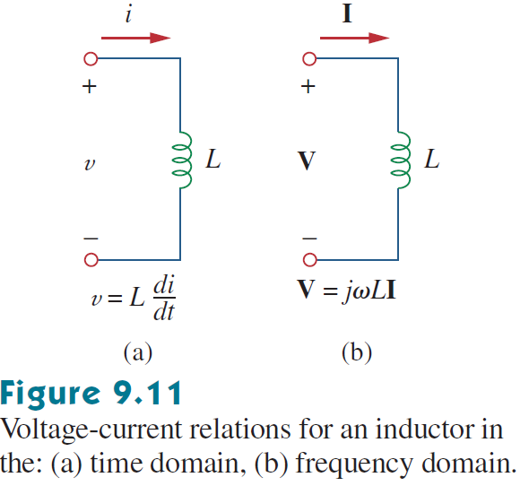
Passive elements in Ac circuit(r, l, c)

Slide 25
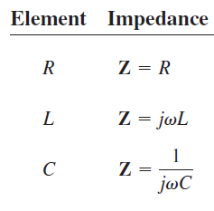
Impedance(continued…)

Slide 26
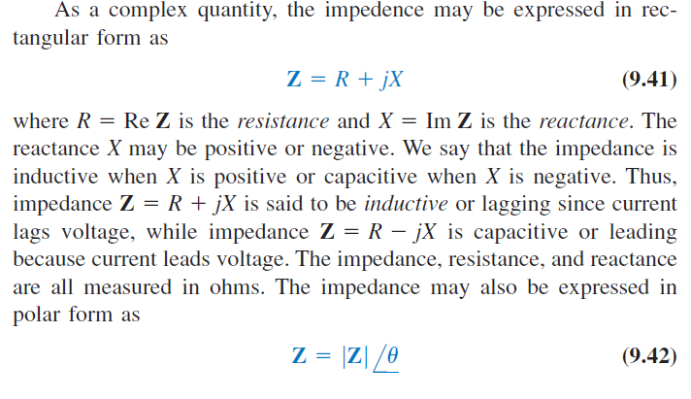
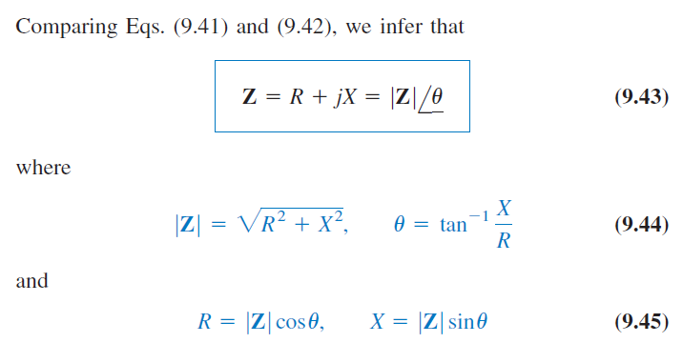
Impedance(continued…)

Slide 27


Admittance

Slide 28
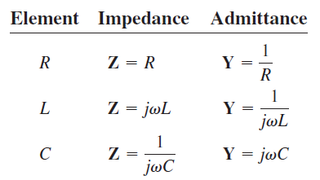
Admittance(continued…)

Slide 29
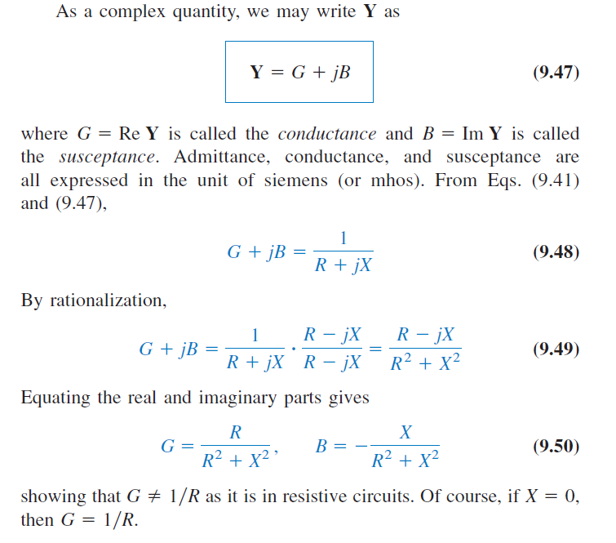
Admittance(continued…)

Slide 30
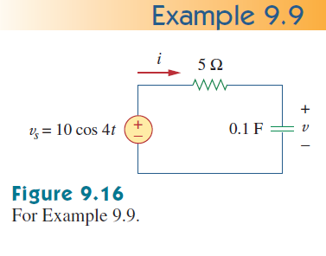
Math Problem Practice:
Reference: Sadiku_Example_9.9

Slide 31
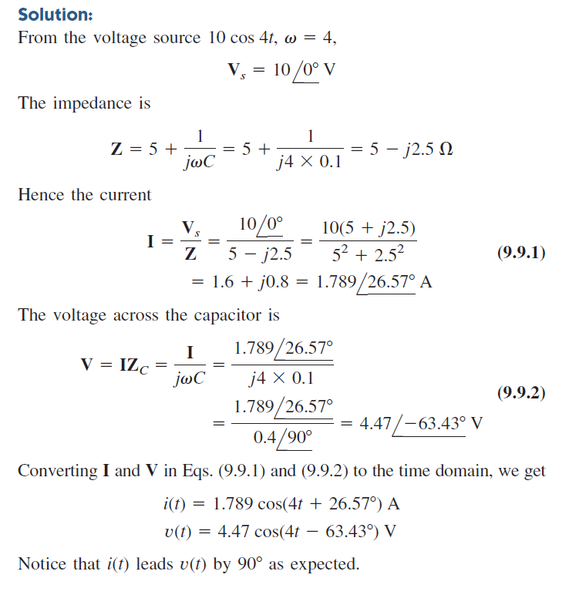
Math Problem Practice:
Reference: Sadiku_Example_9.9

Slide 32
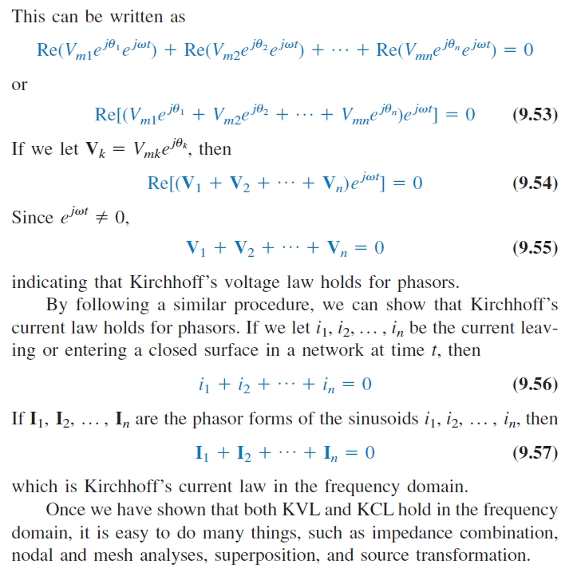
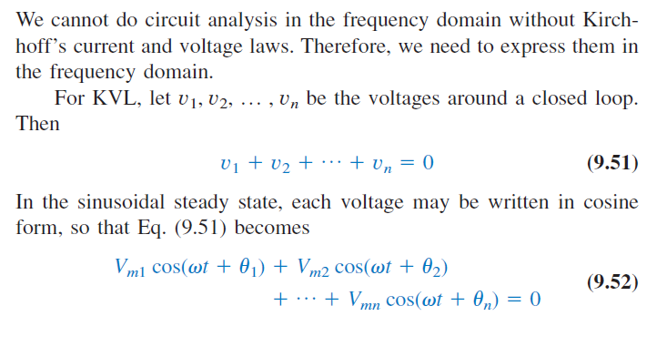
Kirchhoff’s Laws in the Frequency Domain

Slide 33
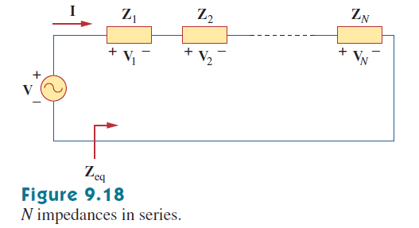
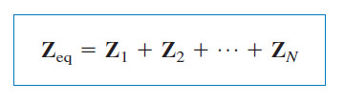
Impedance Combinations(Series)

Slide 34
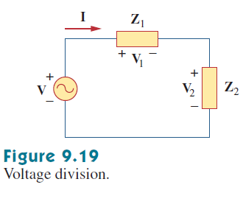

Voltage divider rule(vdr)

Slide 35
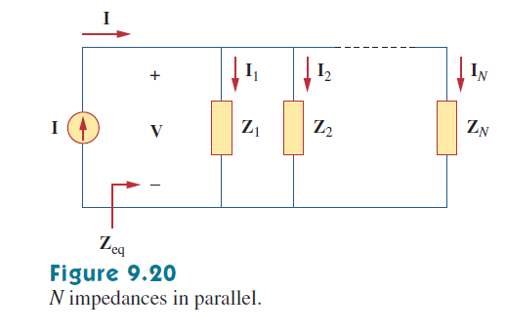
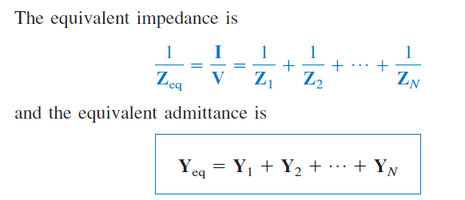
Impedance Combinations(parallel)

Slide 36
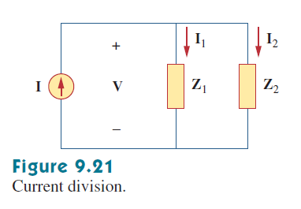

current divider rule(Cdr)

Slide 37
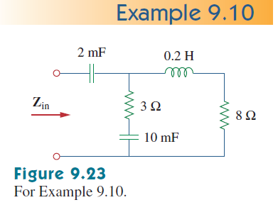

Math Problem Practice:
Reference: Sadiku_Example_9.10

Slide 38
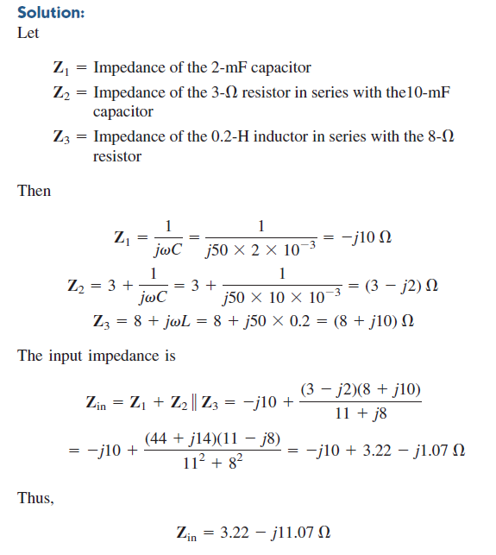
Math Problem Practice:
Reference: Sadiku_Example_9.10

Slide 39
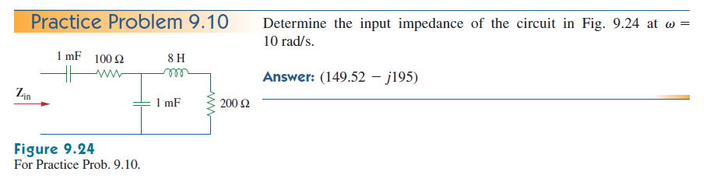
Math Problem Practice:
Reference: Sadiku_Practice_Problem_9.10

Slide 40
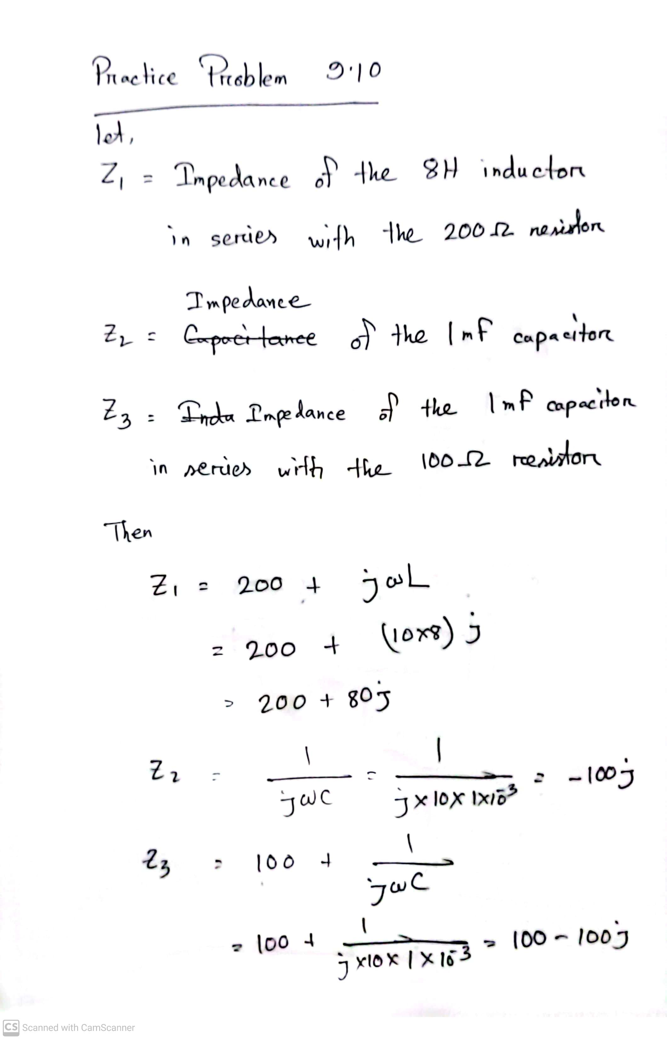
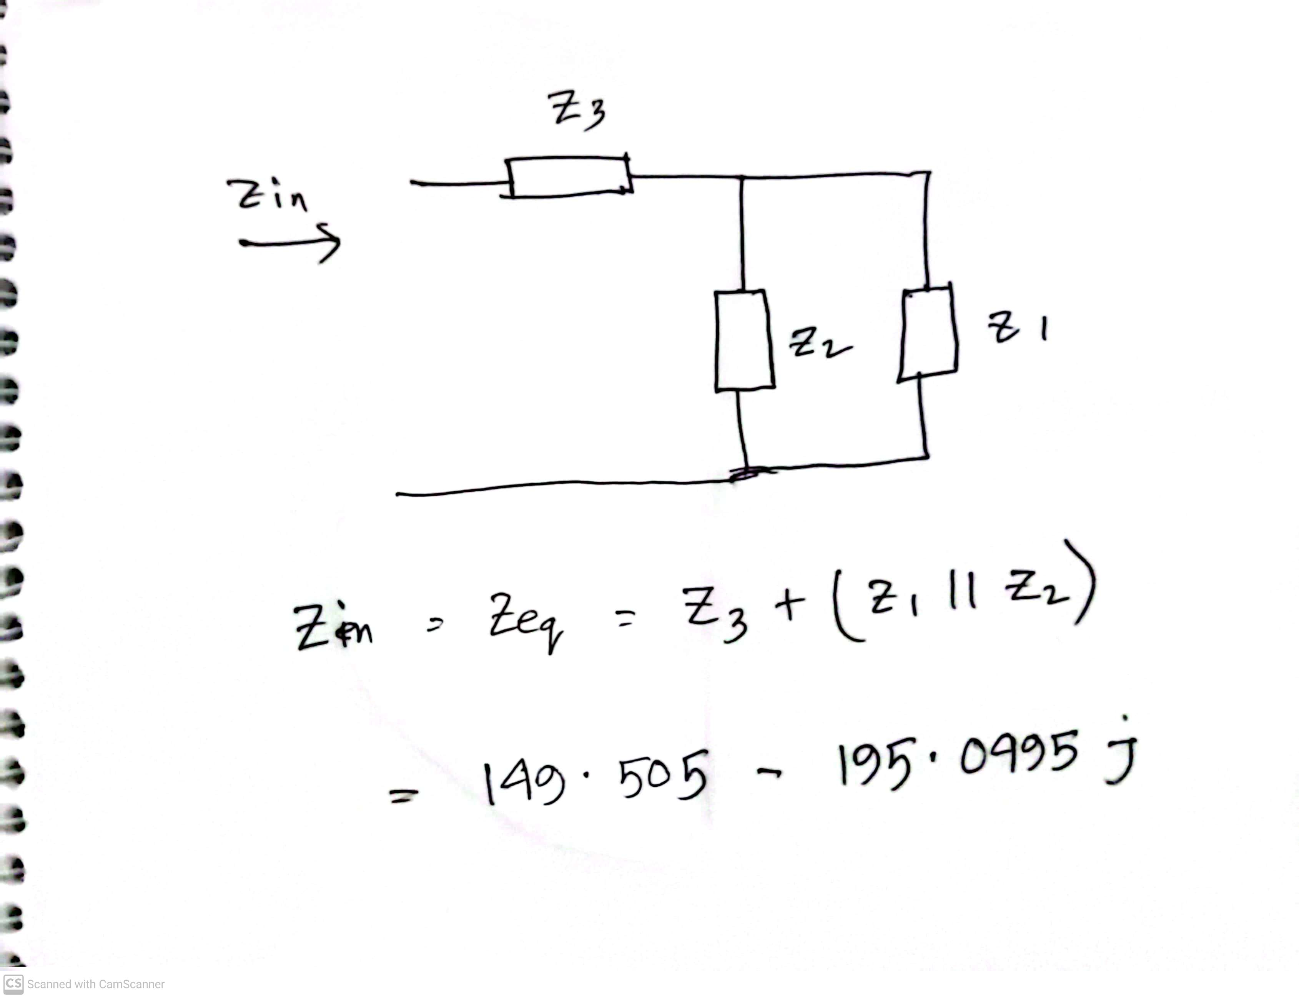
Math Problem Practice:
Reference: Sadiku_Practice_Problem_9.10

Slide 41
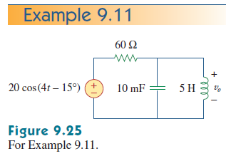

Math Problem Practice:
Reference: Sadiku_Example_9.11

Slide 42
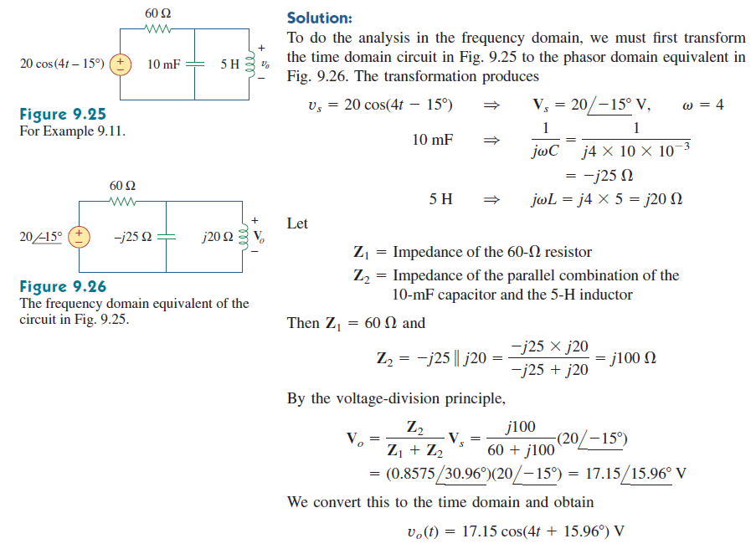
Math Problem Practice:
Reference: Sadiku_Example_9.11

Slide 43
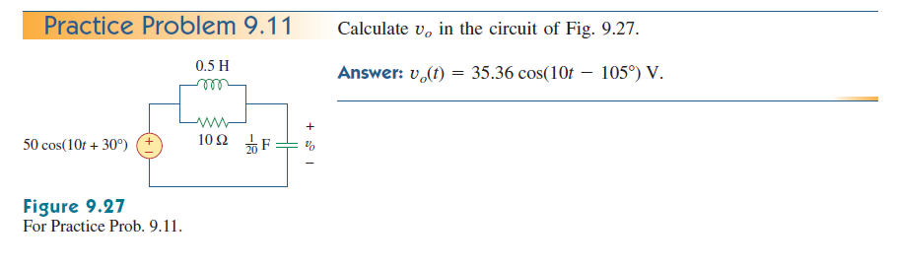
Math Problem Practice:
Reference: Sadiku_Practice_Problem_9.11

Slide 44


Math Problem Practice:
Reference: Sadiku_Practice_Problem_9.11

Slide 45

Math Problem Practice:
Reference: Sadiku_Exercise_9.39

Slide 46

Math Problem Practice:
Reference: Sadiku_Exercise_9.39

Slide 47

Math Problem Practice:
Reference: Sadiku_Exercise_9.45

Slide 48

Math Problem Practice:
Reference: Sadiku_Exercise_9.45

Slide 49

Math Problem Practice:
Reference: Sadiku_Exercise_9.54

Slide 50

Math Problem Practice:
Reference: Sadiku_Exercise_9.54

Slide 51

Fall 2023

Slide 52


Fall 2023

Slide 53


Summer 2023

Slide 54



Summer 2023

Slide 55
References for better understanding
Links to go through in AC Circuit:
Basics of sinusoids and lead-lag concept:
What is Sinusoid | Lead Lag Sine wave (in Bangla) #Sinusoid (youtube.com)
Basics of Impedance and Reactance:
What is reactance and impedance | Difference between reactance and impedance [ in bangla] (youtube.com)
Equivalent Impedance Math:
Example 1 Equivalent Impedance (youtube.com)
Example 2 Equivalent Impedance (youtube.com)
Example : Impedance seen from a terminal (youtube.com)
4. AC Circuit Voltage Divide Rule Problems || AC circuit bangla tutorial (youtube.com)

Slide 56
References for calculator use for complex numbers
Complex Number calculations in calculator:
Complex Number Operations in Calculator (Bangla Tutorial) #ComplexNumberOperationsBanglaTutorial (youtube.com)
FX 991ES + Scientific Calculator Conversion of Rectangular to Polar & Polar to Rectangular (youtube.com)
Rectangular to Polar form in fx-991MS calculator (youtube.com)
Casio FX-991EX Classwiz Complex Numbers: Rectangular to Polar Form Conversions (and Vice Versa) (youtube.com)

Slide 57
Math to Practice from the Book for Exam
Chapter 9
Example:
9.1, 9.2, 9.10
Practice Problem:
9.10
Problem:
9.1, 9.2, 9.6, 9.39, 9.40, 9.44, 9.45, 9.51, 9.54, 9.55

Slide 58
Thank you

